Slide 1
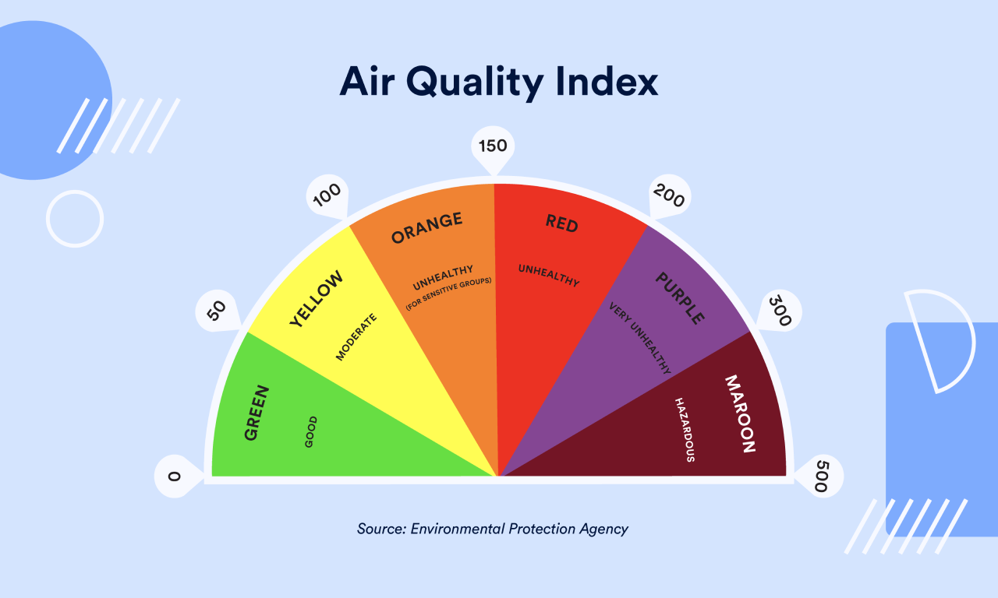
Lecture 7: Air Pollution National Air Quality Index (NAQI) and National Air quality Standards
B Tech – 1st Year UG
Environmental Science (NESV)

Slide 2
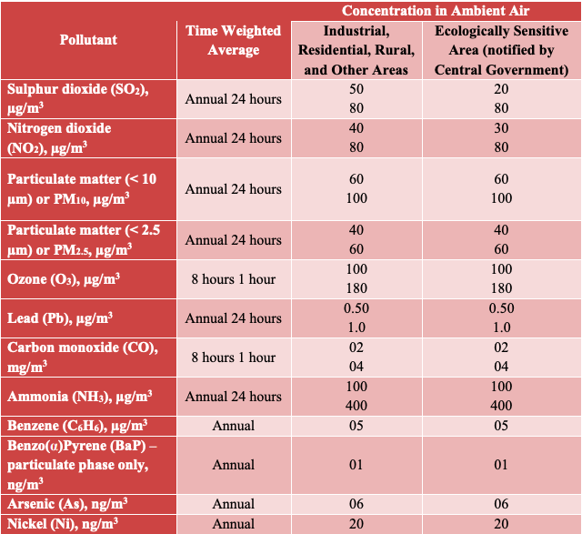
National Ambient Air Quality Standards (NAAQS), 2009
The NAAQS set by the CPCB are applicable to the whole country. The CPCB draws this power from the Air (Prevention and Control of Pollution) Act, 1981.
The current standards (2009) comprise 12 pollutants as follows:
Particulate Matter 10 (PM10)
Particulate Matter 2.5 (PM2.5)
Nitrogen Dioxide (NO2)
Sulphur Dioxide (SO2)
Carbon Monoxide (CO)
Ozone (O3)
Ammonia (NH3)
Lead (Pb)
Benzene
Benzopyrene
Arsenic
Nickel

Slide 3
NAAQI based on 8 air pollutants (Criteria Pollutants)
The Air Quality Index is acquired by measuring emissions of 8 major pollutants present in the air:
Particulate matter (PM2.5, µg/m3). → 24-hr
Particulate matter (PM10, µg/m3), → 24-hr
Ozone (O3, µg/m3), → 8- hr
Nitrogen Dioxide (NO2, µg/m3), → 24 hr
Sulphur Dioxide (SO2, µg/m3), → 24 hr
Carbon Monoxide (CO, mg/m3), → 8hr
Lead (Pb, µg/m3) → 24 hr
Ammonia (NH3, µg/m3) → 24 hr
Readings are noted every hour.
Each country has their air quality indexes based on its air quality standards.

Slide 4
Indian AQI range & probable impacts:
It was lunched in 2014 with “one member - one colour- one description” to judge the air quality by a common man. Developed by CPCB & IIT Kanpur. There are 6 categories of Air Quality in India.
NAQI has a scale from 0-500 and divided into 6 categories.
It is unit less, Colour coded numerical values, indicating the level of Pollution/ the Quality of the air at particular location.
To calculate AQI, data for a minimum of 3 pollutants must be present, of which one should be either PM10 or PM2.5.
Scale range | NAQI category | Health impacts & Colour coding
0-50 | Good (green) | This range defines air quality as good as it shows minimal or no impact on health
51-100 | Satisfactory (Orange) | This is a satisfactory air quality range and it can show effects such as breathing difficulty in sensitive groups.
101-200 | Moderate (Yellow) | Moderate Air quality with impacts such as breathing discomfort for children and elderly people, and people already suffering from lung disorders and heart disease.
201-300 | Poor (Red) | AQI is poor and shows health effects on people when exposed for the long term. People already suffering from heart diseases can experience discomfort from short exposure.
301-400 | Very Poor (Purpel) | This range shows very poor air quality and causes respiratory illness for a longer duration of exposure.
401-500 | Severe (maroon) | This is the severe range of AQI causing health impacts to normal and diseased people. It also causes severe health impacts on sensitive groups

Slide 5
People to quickly determine whether air quality is reaching unhealthy levels in their communities.
AQI Basics for Ozone and Particle Pollution
Daily AQI Color | Levels of Concern | Values of Index | Description of Air Quality
Green | Good | 0 to 50 | Air quality is satisfactory, and air pollution poses little or no risk.
Yellow | Moderate | 51 to 100 | Air quality is acceptable. However, there may be a risk for some people, particularly those who are unusually sensitive to air pollution.
Orange | Unhealthy for Sensitive Groups | 101 to 150 | Members of sensitive groups may experience health effects. The general public is less likely to be affected.
Red | Unhealthy | 151 to 200 | Some members of the general public may experience health effects; members of sensitive groups may experience more serious health effects.
Purple | Very Unhealthy | 201 to 300 | Health alert: The risk of health effects is increased for everyone.
Maroon | Hazardous | 301 and higher | Health warning of emergency conditions: everyone is more likely to be affected.

Slide 6
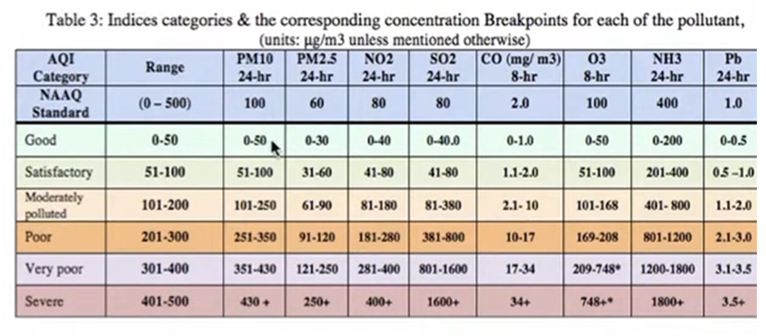
AQI indices category

Slide 7
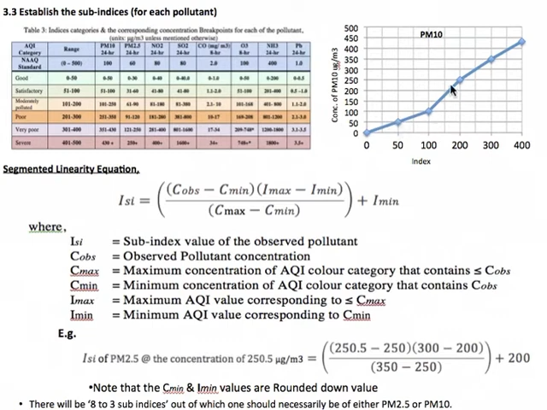
Calculation on sub-indices

Slide 8
AQI Calculation Formulas
The AQI calculation involves determining the individual AQI for each pollutant and then selecting the highest value among them to represent the overall AQI for a specific area. Here are the formulas for calculating the AQI for each pollutant:
3.1 Particulate Matter (PM2.5 and PM10)
AQI of PM2.5 = [(IHI - ILO) / (BPHI - BPLO)] x (Cp - BPLO) + ILO
Where:
AQI_PM25 is the AQI for PM2.5
IHI = AQI value corresponding to the upper boundary of the AQI category
ILO = AQI value corresponding to the lower boundary of the AQI category
BPHI = concentration value corresponding to the upper boundary of the AQI category
BPLO = concentration value corresponding to the lower boundary of the AQI category
Cp = Actual concentration of PM2.5 in µg/m³
AQI Calculation Example 1:
Let's consider an example to demonstrate how to calculate AQI:
Example Scenario:
PM10 concentration (Cp) = 85 µg/m³
Ozone concentration (Cp) = 70 ppb
AQI category boundaries and corresponding AQI values can be found in AQI reference tables.

Slide 9
Solution : AQI Calculation Example 1:
Calculation for AQI PM10 = 85 µg/m³ (Comes under good category, 0-30 range):
IHI = 100, ILO = 50 BHI = 100, BPLO = 50 AQI-PM10 = [(100 - 50) / (100 - 50)] x (85 - 50) + 50 AQI-PM10 ≈ 85
Calculation for Ozone:
IHI = 100, ILO = 51 BHI = 86, BPLO = 0 AQI_O3 = [(100 - 51) / (86 - 0)] x (70 - 0) + 51 AQI_O3 ≈ 86.63
Answer of AQI: In this example, the AQI for PM10 is 85, and the AQI for Ozone is 86.63. Since the Ozone AQI is higher, the overall AQI for this scenario is 86.63, categorized as "Moderate."

Slide 10
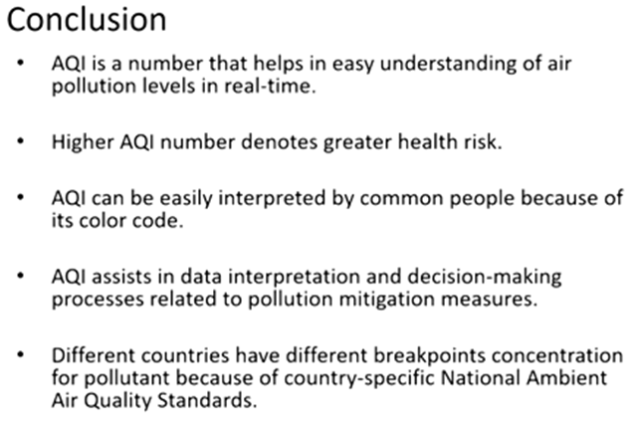

Slide 11
Common questions on NAQI
Q1. What is PM_{2.5} and PM₁₀?
Ans 1: PM_{2.5} refers to the concentration of microscopic particles < 2.5 microns in diameter, and PM 10 refers to the concentration of particles < 10 microns in diameter.
Q2. When was the National Air Quality Index India launched?
Ans 2:The National Air Quality Quality (AQI) India was launched on 17 September 2014 in New Delhi under the Swachh Bharat Abhiyan by Environment Minister Shri PrakashJavadekar.
Q3. How many air pollutants are considered for calculating the NAQI? And name those pollutants.
Ans 3: 8 Nos. PM2.5, PM10, SO2, NO2, O3, CO, NH3, Pb
Q4. How many categories are there under NAQI. Name these categories and score values.
Ans 4: 6 categories: Good (0-50), Satisfactory (51-100), Moderately polluted (101-200), Poor (201-300), Very Poor (301-400), and Severe (401-500).
Q5. Where one can see on-line NAQI?
Ans 5: Main gate of IIT(ISM), Dhanbad.

